Slide 1
Lone Star Analysis, Ltd. Enterprise Project
Competitor Analysis

Slide 2
Project Timescales
Date |  | Activity
18/10/2024 |  | Project Kick-off
w/c 06/01/2025 |  | Project Presentation

Slide 3
Purpose of This Project
You:
Develop your employable skills.
Give you some experience in Industry.
Lone Star Analysis:
Compare our website and online presence with the market and our competitors so that we can improve.
Notes:
I have put some reading on the last slide – this contains a video that explains more succinctly what we do.

Slide 4




Private, Closely-Held Company
Founded 2004
Culture and values driven
More than 5 dozen Patents and Patent Pending solutions
140 Employees
About Lone Star
Diverse backgrounds, education and experience
Heavy systems talent
“People Strategy” is a strategic pillar
We provide Digital Transformation through Predictive and Prescriptive Analytics and Evolved Artificial Intelligence®.
Our solutions enhance decision superiority and help you make smarter decisions faster. Our solutions improve confidence and reduce uncertainty in critical decisions, enabling you to improve operational and financial performance.
Strategic Office Locations
Addison, TX
Washington, DC
Patuxent River, MD
London, England
Oslo, Norway
Lincoln, England
1,500+
Subject Matter Experts
In database, ready to work
Full-time SME relationship management
Extremely diverse subjects
4
© 2023 Lone Star Analysis, Ltd.
Notes:
We have just opened the offices in Lincoln and are now starting to expand – we have office space for 10, and option to expand in a year to double that.

Slide 5
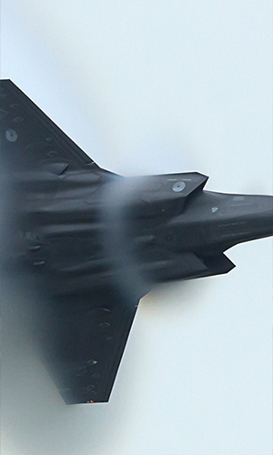

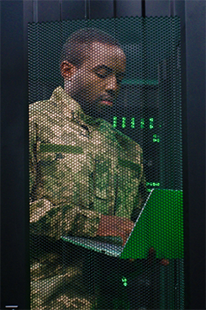
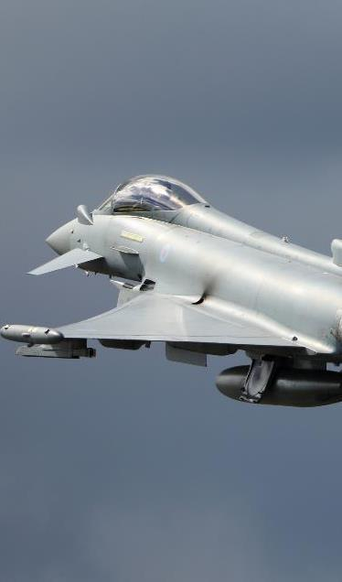
Markets We Focus On
Since 2004, hundreds of leaders have trusted us to deliver actionable answers to complex problems in Aerospace & Defense, Military Services, the Intelligence Community, and for our International Allies.
Aerospace &
Defense
Military
Services
Intelligence
Community
International
Allies

Slide 6



In the US…
In the US focus on multiple different industries, with a number of different products, services, software and teams including:
CAPS – Competitive Pricing (Price to Win)
SEIS – Systems Engineering
OOS – Operational Optimisation Systems
Notes:
Main customer is the DOD (US Air Force)

Slide 7


In the UK…
Most similar to OOS (Operational Optimisation Systems)
Use TruNavigator to make strategic decisions
Main Projects:
RAF
Qatari Air Programs Office
NHS

Slide 8
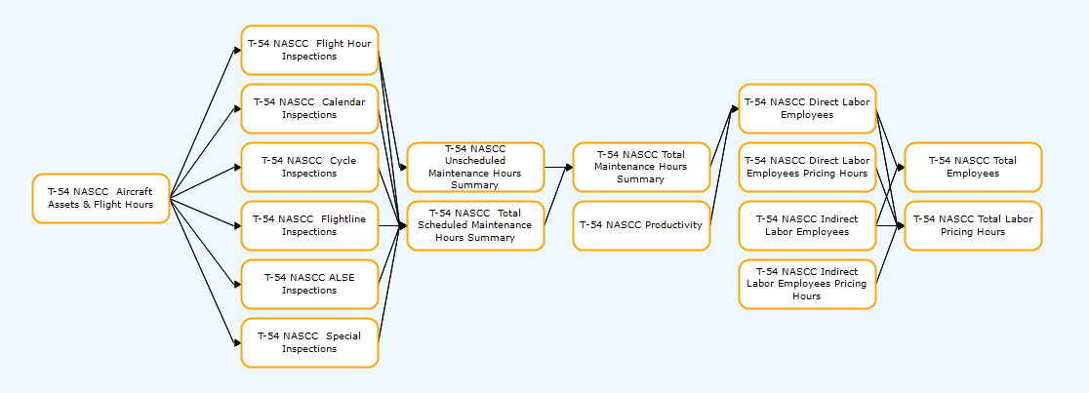
TruNavigator
Modelling Software
Uses Evolved AI (stochastic non-convex optimisation)
Notes:
I have put some reading on the last slide – this contains a video that explains more succinctly what we do.

Slide 9

What is a Competitor Analysis?
A competitor analysis is an assessment of the strength and weaknesses of a company.
It can be used to help companies with strategic decisions such as:
Market Focus
Product Offer
Employee Value Proposition
Customer/Employee Acquisition and Retention

Slide 10

Key Points
We operate in the space of Evolved AI driven decision support services, there is a lot of competition for both the customers and the employees.
We are principally Lincoln based with an office in the Science and Innovation Park, we have key customers in defence, and in the Lincolnshire area.
We are hoping to expand three-fold in the next few years.

Slide 11
Competitor Analysis
This will involve looking at how Lone Star Analysis (LSA) presents itself online compared to its competitors, then creating actionable suggestions regarding the online presence of LSA.
We propose to work with you over the 8 weeks on six phases:
Project Kick-Off
Customer Identification
Analysis
Findings and Recommendations
Presentation

Slide 12
Phase 1 – Project Kick-off
Timelines
Understand the project
Notes:
We want you to spend some time getting to know and understand the company – look at our online presence. You will need to read and understand the following...
Dials Video - https://www.youtube.com/watch?v=uTQ-SCQjXbA
Piano Tuners in Lincolnshire - https://lone-star.uk/2024/01/09/how-many-piano-tuners-in-lincolnshire-how-evolved-ai-helps-us-answer-seemingly-impossible-questions/
Blog Posts:
https://lone-star.uk/2023/11/04/predictive-human-maintenance/
https://lone-star.uk/2023/12/20/a-new-approach-to-digital-twins/

Slide 13
Phase 2: Competitor Identification
We will give you a list of relevant competitors. Use this to identify the other relevant competitors to LSA.
Competitor selection criteria:
Problems we compete to solve
Solutions we compete to provide
The type of people we compete to hire
Brand that we are building
Locations
We would like you to set up a meeting with LSA to discuss the competitors chosen and discuss the next phase of the work.
Notes:
List of Competitors:
Aerogility
Dassault
Faculty
We propose this happens before the w/c 18th November.

Slide 14
Phase 3: Analysis
Meet with LSA to choose appropriate analysis approaches/frameworks/techniques/ methods. We ask that participants do some prior reading and research on analysis techniques.
Use the selected analysis approaches to research potential analysis tasks and questions (see examples). While the focus will be on doing ‘desk research’, students may consider approaching subject matter experts at UoL for help/guidance.
Hold a mini workshop (led by LSA) to ‘Collect, Choose, Create, and Commit’ to the set of analysis questions.
Use the analysis questions to evaluate the online content of the competitors.
Using the relevant analysis approaches, compare and contrast the online content of three companies (of LSA’s choosing).
Notes:
This can happen at the previous meeting
Example Research Questions:
How do LSA perform on search engines based on key words that describe what LSA do in the UK, and how does this relate to similar competitors?
What connections to other online platforms (i.e., YouTube/LinkedIn) do we have?
How to we compare to other companies in our offer to new employees?
What is the look and feel of the website? Modern/Professional/Defence/Boring?

Slide 15
Phase 4: Findings and Recommendations
Based on the findings of the mini-workshop, please present and discuss the findings of your work. We would like you to include:
Presentation: Present and discuss a list of actionable recommendations that could be implemented by LSA on improvements/changes that could be made to the website and other social media platforms. Recommendations should focus on changes to online content and positioning, not changes to the LSA business or operations.
Write Up: Ensure the report is clearly structured with a clear table of contents. Include a 1 to 2 Page Executive Summary.
Notes:
Final review – w/c 06/01/2025

Slide 16
Example Research Questions …
How do LSA perform on search engines based on key words that describe what LSA do in the UK, and how does this relate to similar competitors?
What connections to other online platforms (i.e., YouTube/LinkedIn) do we have?
How to we compare to other companies in our offer to new employees?
What is the look and feel of the website? Modern/Professional/ Defence/Boring?

Slide 17


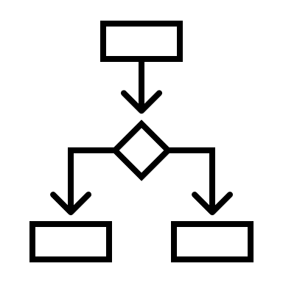


Skills Development
Research and analysis skills
Strategic analysis
Strategic human capital
Market and brand analysis
Tech analysis AI
Decision support analysis
Strategic thinking
Communication and presentation
Critical thinking and problem solving

Slide 18
Reading
https://lone-star.uk/2024/01/09/how-many-piano-tuners-in-lincolnshire-how-evolved-ai-helps-us-answer-seemingly-impossible-questions/
https://www.youtube.com/watch?v=uTQ-SCQjXbA
https://lone-star.uk/2023/11/04/predictive-human-maintenance/
https://lone-star.uk/2023/12/20/a-new-approach-to-digital-twins/

Slide 19
Contact Details
Grace Walburn - gwalburn@lone-star.uk
UK Website Link: https://lone-star.uk/
US Website Link: https://www.lone-star.com/
Address:
Lone Star Analysis
Alchemy Building
Science & Innovation Park
Poplar Avenue
Lincoln
LN6 7GZ
What3Words:
units.target.member

Slide 20
Questions?

Slide 21
LOCATIONS
EXECUTIVE
CONTACTS
4505 Excel Parkway, Suite 100
Addison, TX 75001
Main. (972) 690-9494
44425 Pecan Court
Suite 125
California, MD 20619
Main. (240) 925-4960
1800 Diagonal Road
Suite 600
Alexandria, VA 22314
Main. (571) 366-1710
Rex House, 4 – 12 Regent Street
London, SW1Y 4PE
United Kingdom
Apotekergata 10
Oslo, 0180
Norway
Alchemy Building
Science & Innovation Park
Poplar Avenue, Lincoln
LN6 7GZ
Robin Adlam
@
RAdlam@Lone-Star.uk
Rob Bennett
@
RBennett@Lone-Star.uk
www.Lone-Star.uk

